Slide 1

Web technologies using java
Course 3 – spring core

Slide 2
agenda
Ioc and di
Bean scopes
Eager versus lazy instantiation
aspects

Slide 3
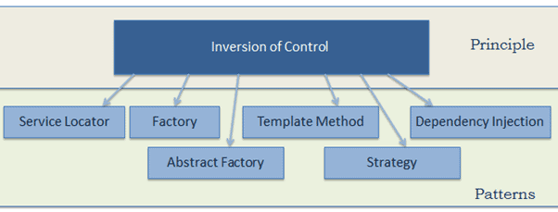
Ioc and di
IoC (Inversion of Control): a programming principle in which custom-written code receives the flow of control from a generic framework (also known as the Hollywood Principle - "Don't call us, we'll call you")
Inversion of Control is a key part of what makes a framework different to a library:
a library is a set of functions that you can call. Each call does some work and returns control to the client.
a framework has some abstract design, with more behavior built in. To use it, you need to insert your behavior into various places in the framework (by subclassing or by plugging in your own classes). The framework's code then calls your code at these points.
DI (Dependency Injection): a technique based on IoC, used by Spring to set a value for a specific field or parameter.

Slide 4
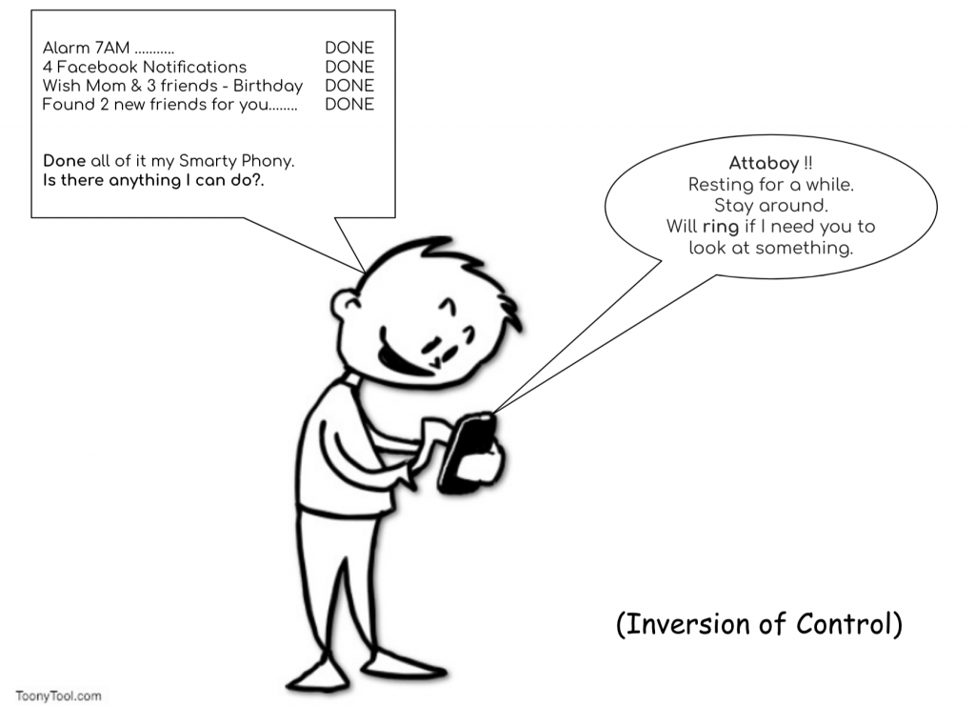
Ioc and di

Slide 5
Bean scopes
Simple bean scopes:
singleton
prototype
Web aware bean scopes:
request
session
application

Slide 6
Singleton scope
Singleton beans:
the default Spring bean scope
one instance per Spring context
used for immutable beans because they are shared among multiple concerns
autowiring by constructor helps obtaining immutable beans

Slide 7
Prototype scope
Prototype beans:
one instance per every usage of the bean
may be mutable
@Scope(BeanDefinition.SCOPE_PROTOTYPE)
don’t inject a prototype bean into a singleton bean (the prototype bean will be created only once)

Slide 8
Eager versus lazy instantiation
Eager instantiation:
Spring creates the bean when the context is created
default approach
better performance
fail-fast approach for bean creation
Lazy instantiation:
Spring creates the bean when it is first needed
@Lazy
avoids creation of unnecessary beans for certain parts of the application

Slide 9
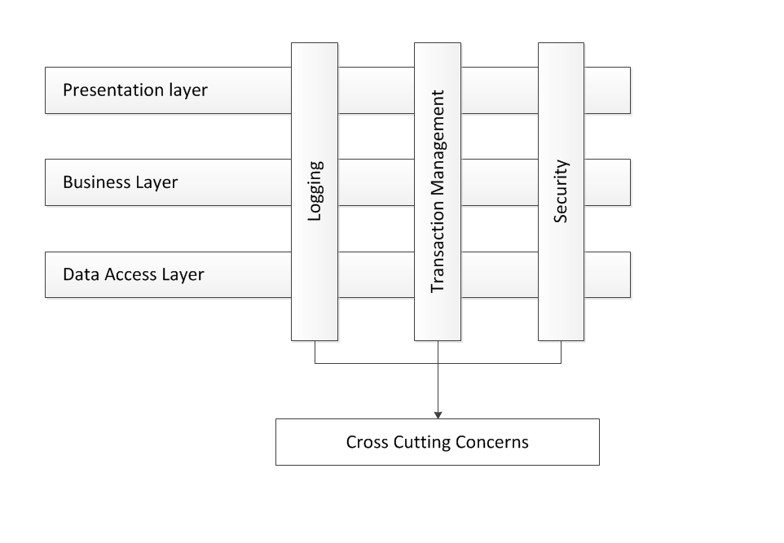
aspects
AOP (Aspect Oriented Programming)
a way in which a framework intercepts methods calls and possibly alters the execution of methods
decouples the code
modularization of cross cutting concerns
some Spring implementations of aspects:
transactions
security
caching

Slide 10
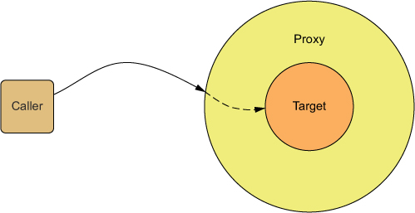
aspects
Aspect: logic the framework executes when you call specific methods.
Key concepts:
the object containing the methods you want to enrich with functionality -> target object
the logic you want Spring to execute when you call specific methods -> aspect
when should Spring execute this logic (before the method call, after the method call etc) -> advice
the methods that Spring needs to intercept -> pointcut
Spring provides a proxy to the target object, which manages the calls to the real method and applies the aspect logic -> weaving

Slide 11
aspects
To implement an aspect:
Enable the aspect mechanism: @EnableAspectJAutoProxy on the configuration class
@Aspect on a new class, defined as a bean in the Spring context.
Define a method that will implement the aspect logic and tell Spring when and which methods to intercept using an advice annotation.
Implement the aspect logic.

Slide 12
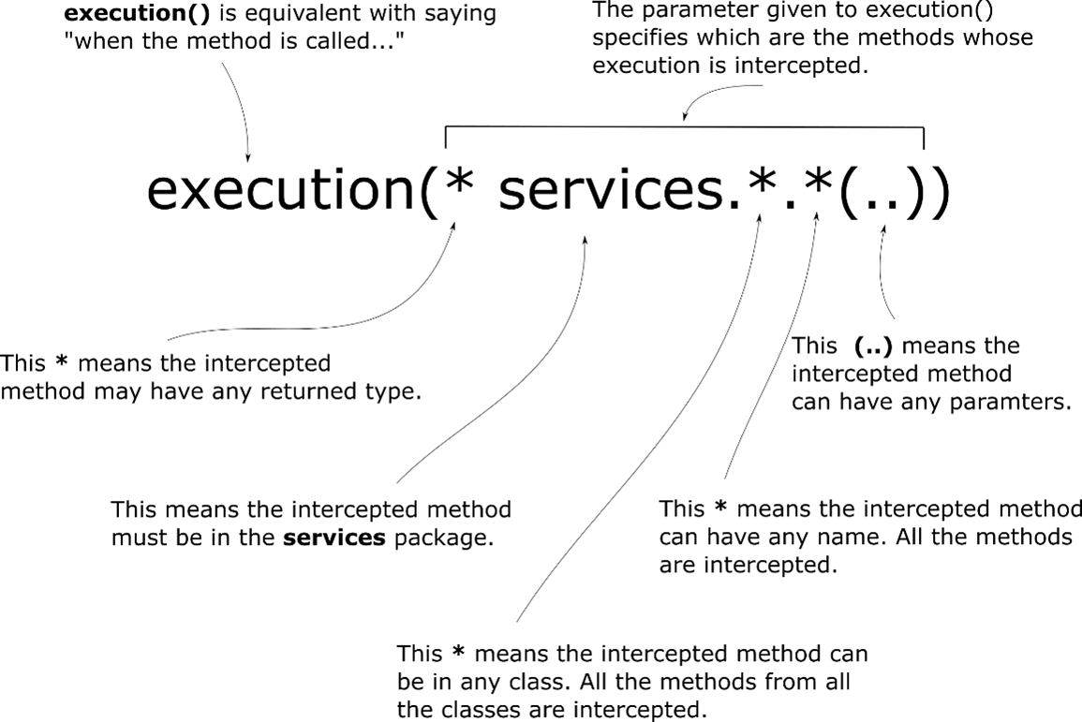
aspects

Slide 13
aspects
Advices:
@Around – calls the aspect logic before, after or instead the execution of the intercepted method
@Before – calls the aspect logic before the execution of the intercepted method.
@AfterReturning – calls the aspect logic after the method successfully returns. The aspect method isn’t called if the intercepted method throws an exception.
@AfterThrowing – calls the aspect logic if the intercepted method throws an exception.
@After – calls the aspect logic always after the intercepted method execution, both if the method successfully returned or threw an exception.

Slide 14
bibliography
Spring in Action, by Craig Walls
Youtube Spring playlist, by Laurentiu Spilca
Spring Aspect, by Ramnivas Laddad
https://docs.spring.io/spring-framework/docs/current/spring-framework-reference/core.html#aop-ataspectj

Slide 15

Q&A

Slide 16
THANK YOU
DANIELA CIUPERCA

